Slide 1

The Human-Mouse: Disease Connection in MGI (BETA)
Short Course Bioinformatics Workshops
July 2014

Slide 2
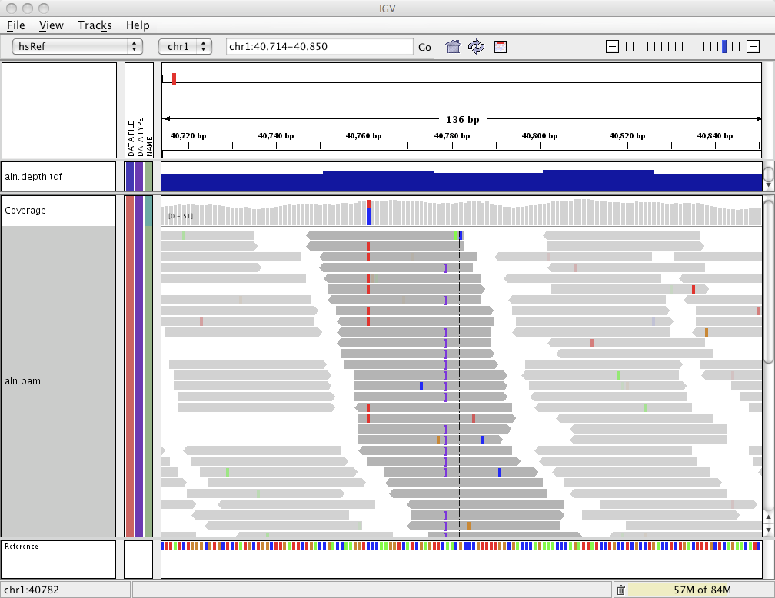

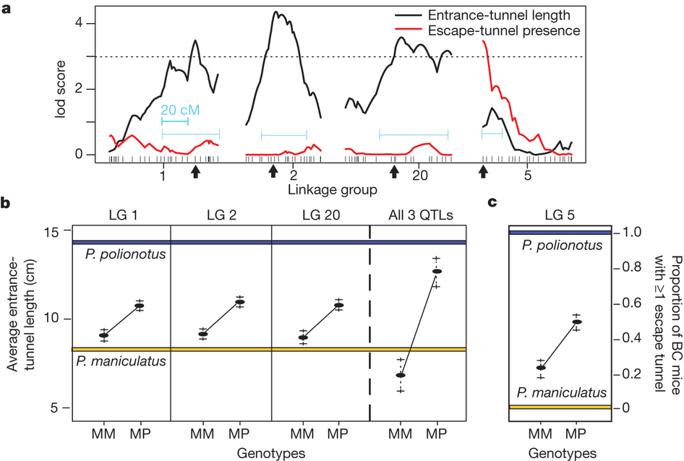
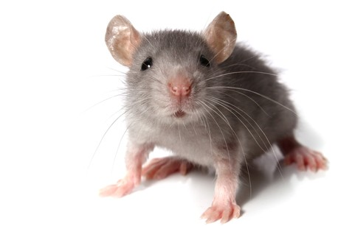
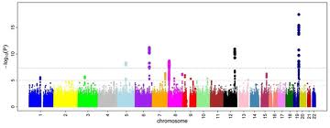
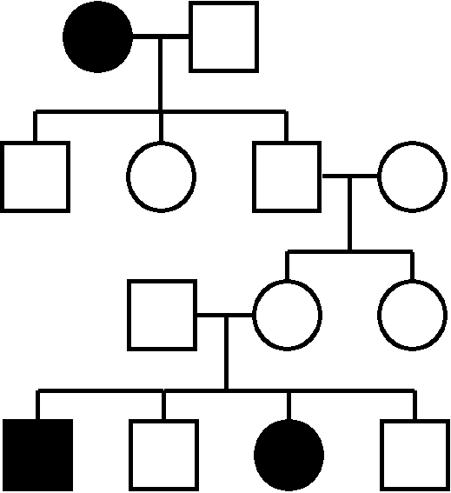
Connecting Mouse Models to Human Disease
Notes:
The Human Mouse Disease Connection, or HMDC, is a clinical genetic research and translational tool allowing a rapid, visual association between genes and their phenotypes. You can begin with a gene list such as one derived from an exome sequencing result in a specific mouse or human patient, a genomic region defined by a GWAS or QTL association study, a disease, or an observed phenotype.

Slide 3
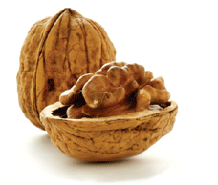
HMDC in a Nutshell
Search for mouse models by
gene symbol (mouse or human)
exome results (VCF file)
genome locations
key words
Quick access to phenotype and disease annotations, references, mouse model availability

Slide 4
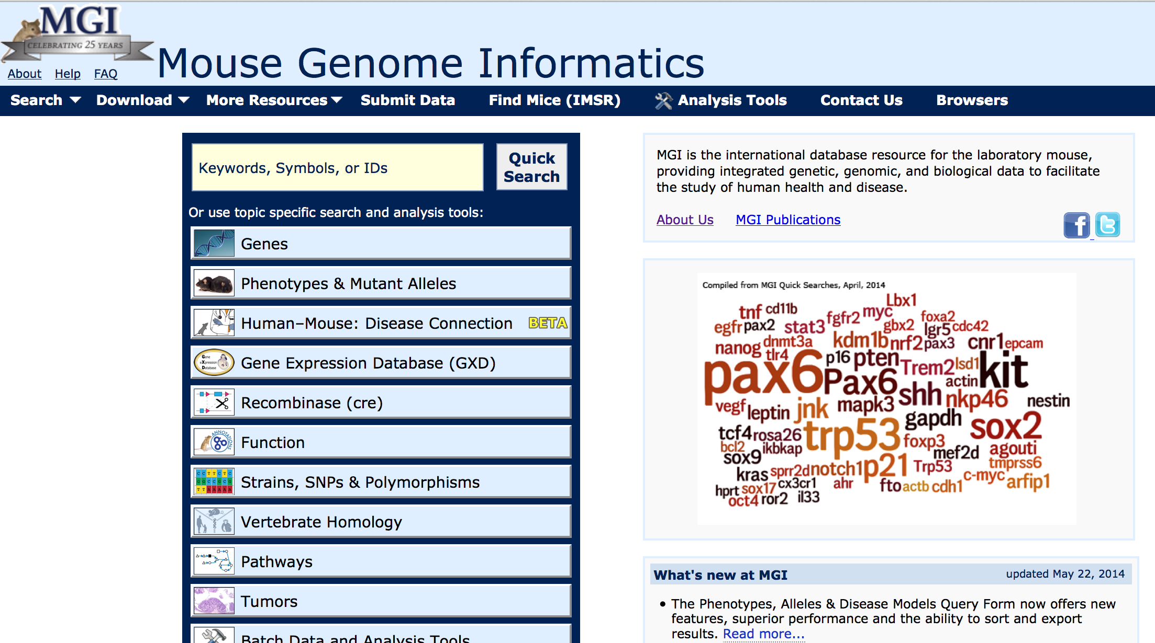
Mouse Genome Informatics
http://www.informatics.jax.org

Slide 5
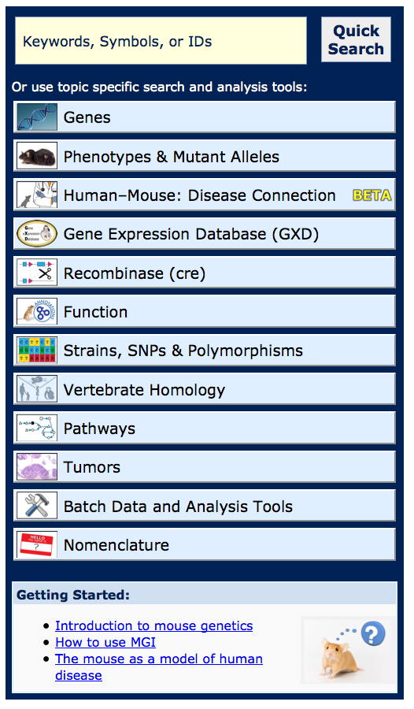
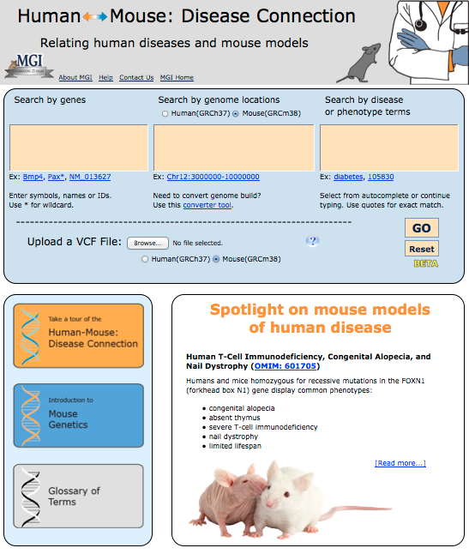
Notes:
To access the HMDC, simply click on the button from the Mouse Genome Informatics homepage. On the Human-Mouse Disease connection homepage, three boxes appear allowing you to begin your search by gene, genome location or disease terms. You additionally have the option to upload a VCF file or a text file with gene symbols. Below the search boxes on the left, you can see a page tour, a quick introduction to mouse genetics and a glossary; and on the right, a spotlight section which compares a specific human disease to it’s mouse model.

Slide 6
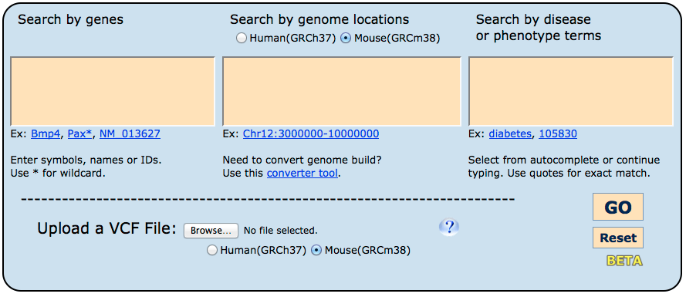
Search by Gene Symbol
Gja8
Mapk10
Rsph9
Il20ra
Jak3 Frg1
Notes:
Please notice as well that entry of both human and mouse gene symbols, locations and annotations are supported. In this example, we’ll run a simple “genes” search with the following 6 genes, simply by pasting them into the first window on the left.

Slide 7
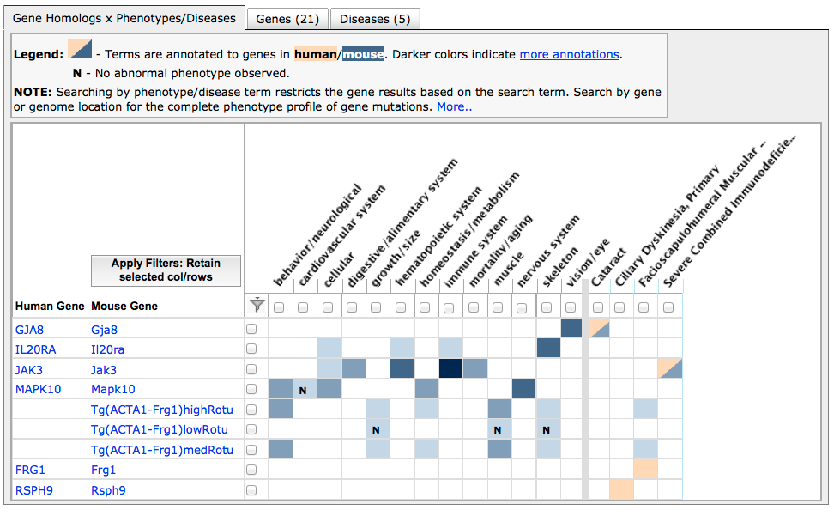
View associated gene, phenotype and disease results
Mammalian (mouse)
Phenotypes
Human disease (OMIM)
Notes:
This reveals a visual grid of associated phenotype and disease results. Each row corresponds to a gene, and then each column represents a phenotype or disease association. Coloured boxes at the intersection indicate that a particular gene has an annotation within that system. <click> On the left of the grid, in blue, you see mammalian phenotype systems which comes from mouse data and annotations. On the right, you see human diseases, where orange indicates that the gene has been associated from studies in human patients and loaded from OMIM, and blue indicates that a mutant mouse has been described as a model of the human disease. Bi-coloured boxes with both blue and orange indicate that mutations in this gene have been disease-associated in both species. I’ll also draw your attention to the additional “Genes” and “Diseases” tabs in behind, which we’ll look into later

Slide 8
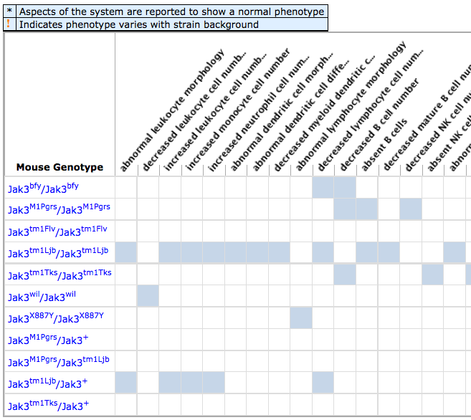
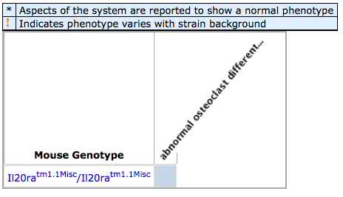
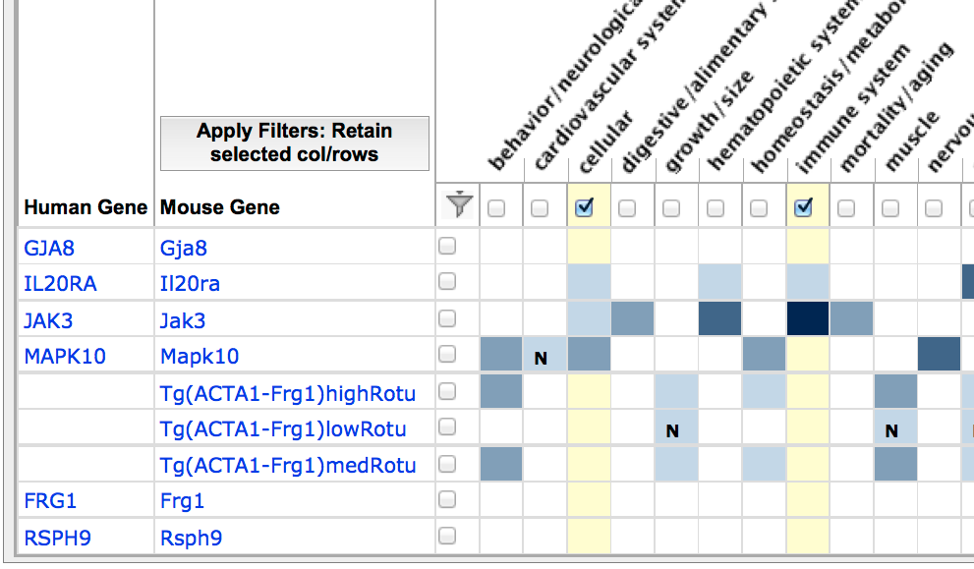
Click to view MP terms and genotypes
Notes:
A very light coloured box, such as here at the intersection of Interleukin 20 and “cellular phenotype” may bring up a single annotation, where you can see the precise allele in which a cellular phenotype was reported, along with the more specific term of “osteoclast differentiation” Clicking on a dark coloured box, as seen at the intersection of Jak3 and “immune system”, reveals multiple Jak3 alleles and many more precise terms under the umbrella of immune system.

Slide 9
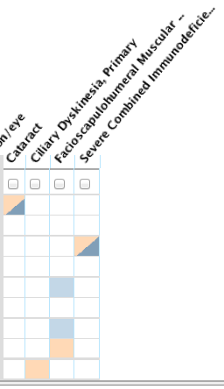
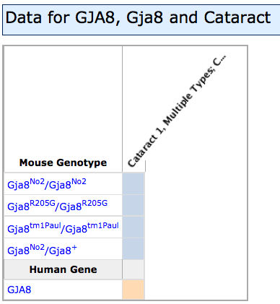
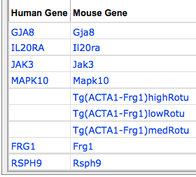
Disease associations
Notes:
Similarly, on the right side of the grid, clicking the cells with data will reveal the details of gene-disease associations. Gap junction 9 is an example of a gene which has been associated to cataracts in both humans and mouse, and you can see that four different alleles in the mouse have all been used as cataract disease models.

Slide 10
Filter grid by phenotype and gene (select what you want to keep)
Notes:
Along with exploring and drilling down into the data, it is possible to apply filters for both columns and rows which will hide any systems or genes that have no data in the selections. This will filter all tabs.

Slide 11
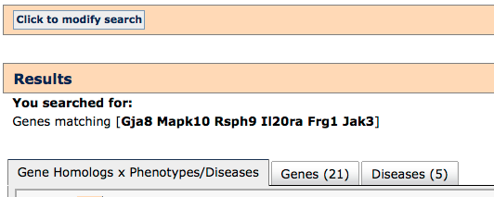
Tabs for Genes & Diseases information
Notes:
Along with the grid, I’ll remind you that there is also a Genes and Diseases tab.

Slide 12
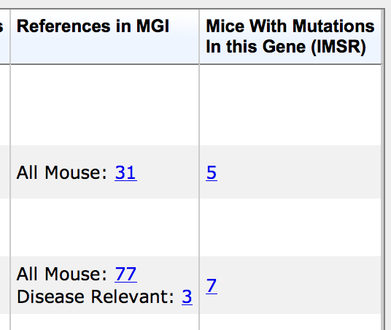
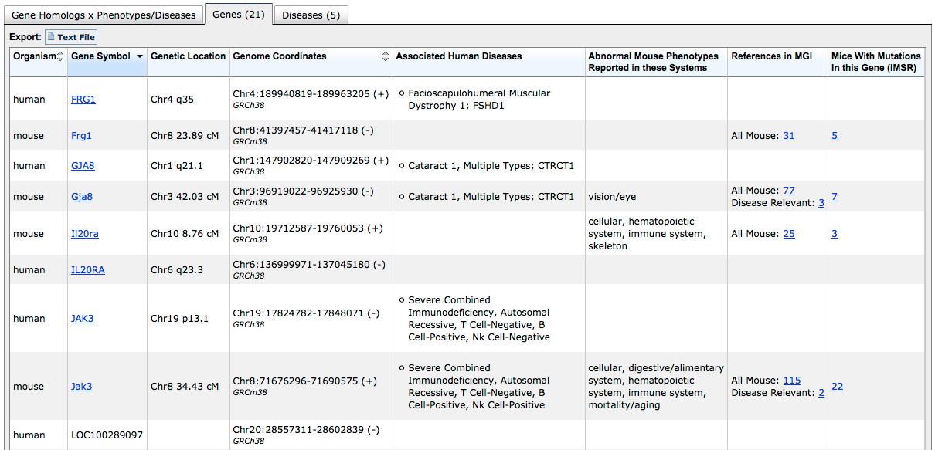
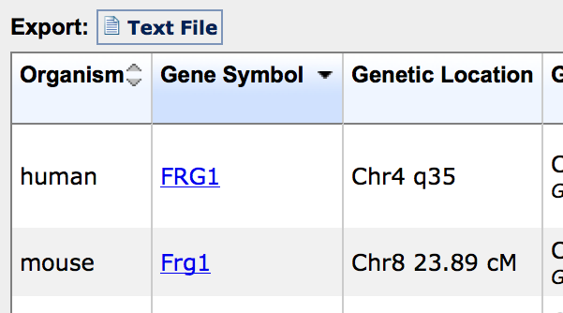
Genes tab: References and mouse models

Slide 13
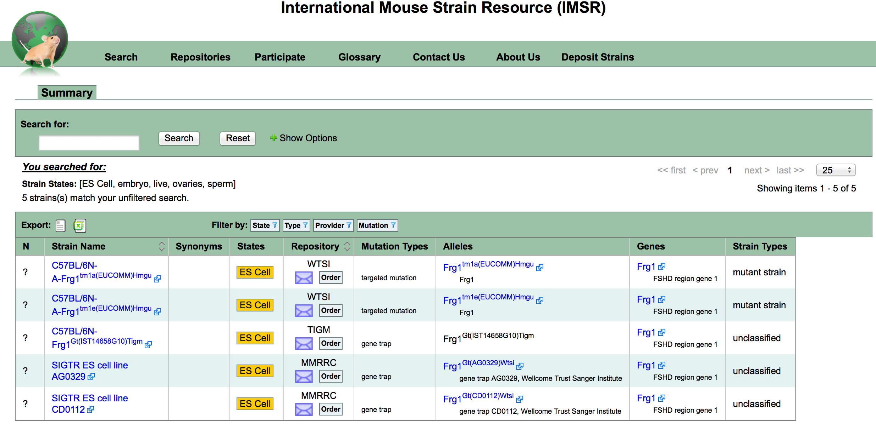
IMSR = International Mouse Strain Resource
www.findmice.org

Slide 14
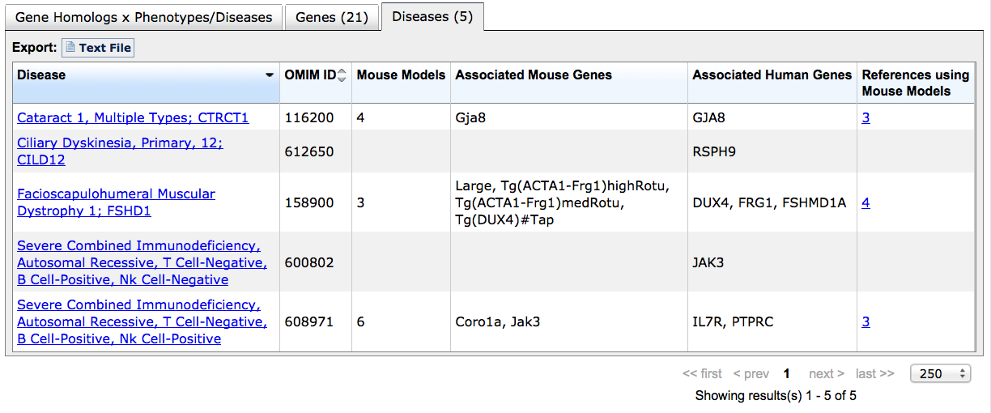
Diseases tab: Disease and mouse model details

Slide 15
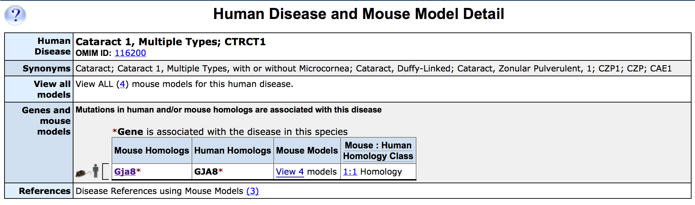
In this case both the mouse gene and human ortholog are associated with the Cataract 1 disease.

Slide 16
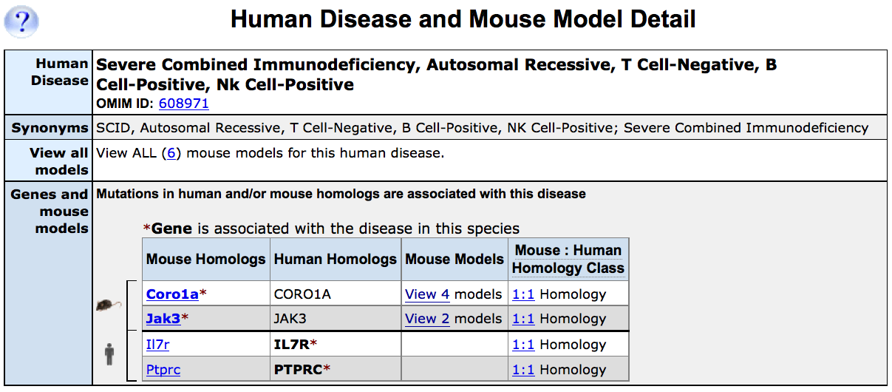
In this case different mouse and human genes are associated with the disease.

Slide 17
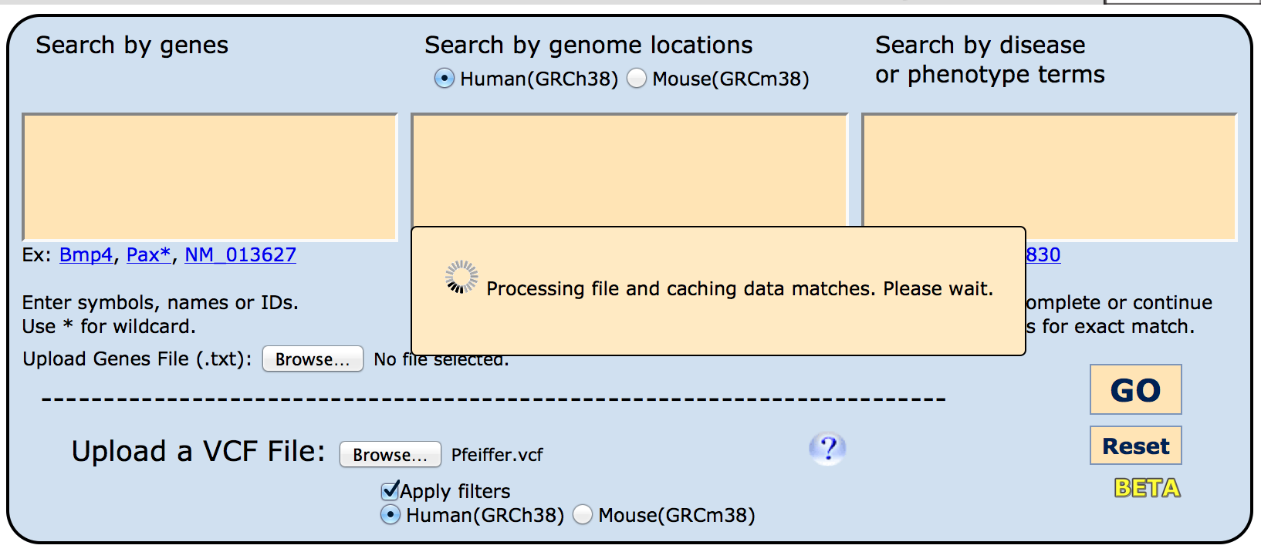
Search by genes in VCF files
An example vcf file is available on the Dropbox site

Slide 18
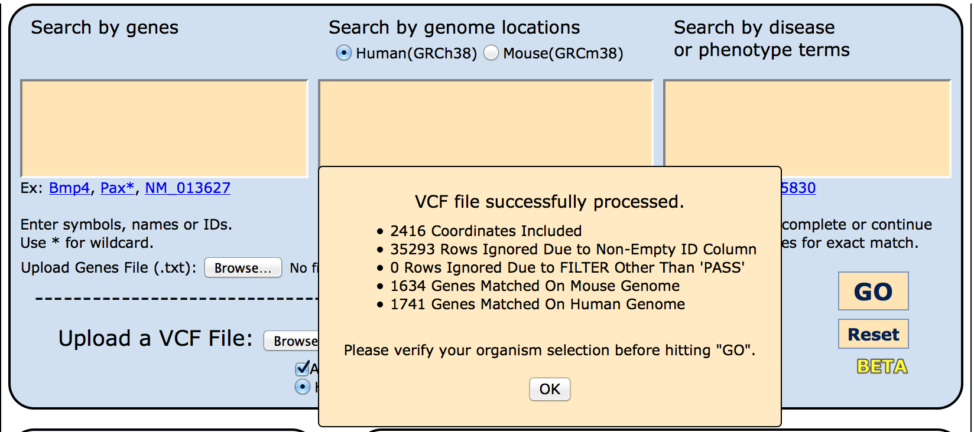

Slide 19
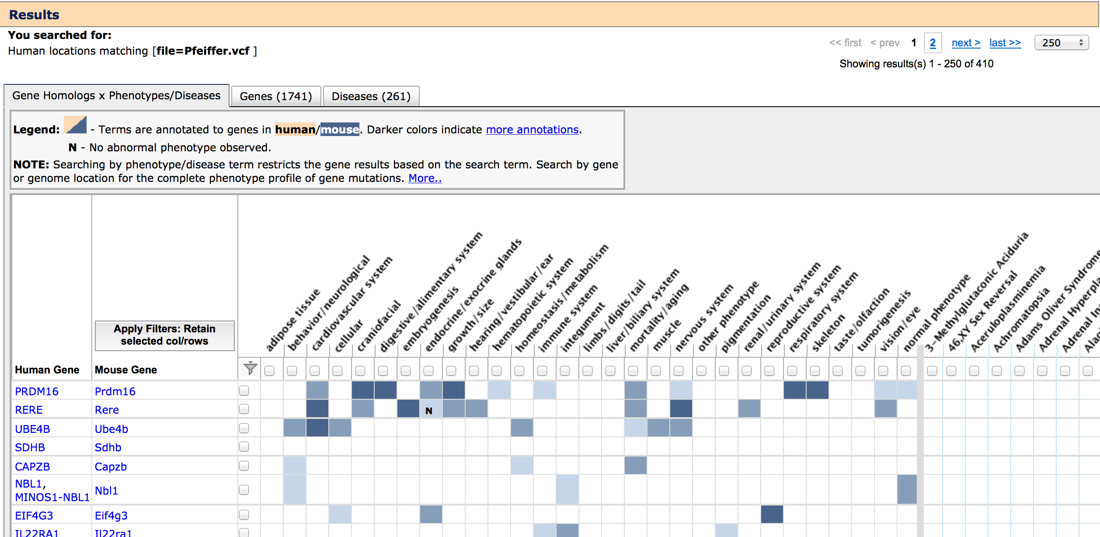

Slide 20
Search terms can be combined
.
Chr1:150000000-250000000
type “cleft palate” (matches whole)
or
type cleft palate (matches as two terms)
or select
cleft palate Mammalian phenotype
or select
Cleft Palate; CP [Cleft palate isolated, CPI] OMIM

Slide 21
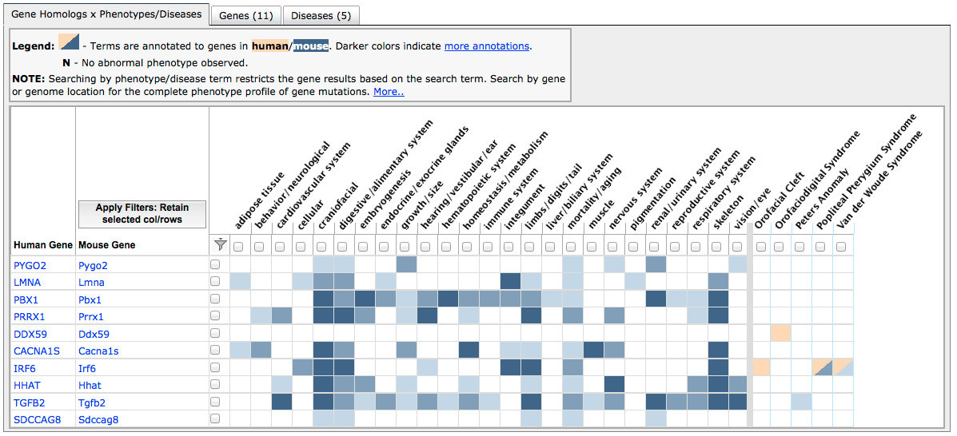
Results for a search by both genome region and key word
at least one mouse homolog genotype contains “cleft palate” (or child term) as an MP annotation
same MP genotype is a disease model, or human disease name/synonym contains “cleft palate”

Slide 22
Summary
The Human-Mouse: Disease Connection supports rapid access to disease and phenotype associations
The HMDC is in Beta release
contact mgi-help@jax.org with questions and suggestions

Slide 23
Your Turn !
Use the HMDC for a disease, gene, or phenotype you are interested in or have heard about at the Short Course
Try the human.vcf file on the DropBox site
https://www.dropbox.com/sh/seqishl631f363x/AADoBskzYjPt_iJI21dxJqV8a

